Slide 1

Parallel and Distributed Computing
Parallel models and Communication

Slide 2
“We don’t get faster by waiting for CPUs; we must design faster algorithms!”
Past | Present
Single CPU → Sequential Programs | Multi-Core CPUs, GPUs, Clusters
MHz race (clock speed scaling) | Core count & parallel throughput
Moore's Law (frequency scaling) | Power wall → parallelism required

Slide 3
Serial vs Parallel Thinking
Serial mindset → "Do task A completely, then B, then C"
Parallel mindset → "Can I break A, B, C into chunks and execute together?"
Example: Serial carpenter builds a chair alone. Parallel workshop assigns legs, backrest, and frame to different workers.
Why Parallelism?
Reason | Explanation
Performance | Faster execution using more cores
Problem Size | Can solve larger datasets
Scalability | Can add more machines instead of buying super-expensive single CPU
Cost-Effective | Clusters of cheap machines > single supercomputer

Slide 4
Parallel Computing: Executing multiple operations simultaneously to solve a problem faster than a single processor could.
Parallelism in Daily Life
Scenario | Type
Multiple users browsing on a server | Task Parallelism
GPU rendering pixels of an image | Data Parallelism
Video streaming buffer pipeline | Pipelining (staged parallelism)

Slide 5
Serial vs. Parallel (the mental shift)
Serial (traditional)
One instruction at a time on one processor.
Problems solved step-by-step. Parallel (modern)
Break the problem into parts that can run concurrently.
Each part runs its own instructions at the same time on different processors/cores.
Needs some coordination (who does what, when to exchange data).
Rule of thumb: If parts of your problem don’t depend on each other (or depend only occasionally), you can often parallelize.
Serial Execution | Parallel Execution
Single core | Multiple cores/nodes
One step at a time | Many tasks at once
No coordination needed | Needs synchronization

Slide 6
Why go parallel?
Speed / Cost More cores ⇒ less time; clusters can be built with commodity parts.
Solve bigger problems Serial programs may run out of RAM/time; parallel machines combine resources.
Concurrency Real systems have many things happening at once; parallel hardware matches that reality.
Use non-local resources Tap remote machines when local ones are insufficient (clusters/clouds).
Factor | Why it matters
Speed | Finish faster
Scale | Solve bigger problems
Cost | Commodity clusters cheaper than 1 big machine
Resource Access | Use remote GPUs/cloud nodes

Slide 7
Flynn’s Taxonomy (4 architectural “modes”)
Think in terms of the number of instruction streams and data streams.
SISD (Single Instruction, Single Data) Classic serial machine; one instruction sequence over one data stream. Example: Simple C loop on single CPU
SIMD (Single Instruction, Multiple Data) Many processing elements run the same instruction over different data. Works best for image processing, arrays-Great for image/graphics, vector operations; lockstep and deterministic.
MISD (Multiple Instruction, Single Data) Multiple instruction streams consume the same data stream. Rare in practice; shows up as special pipelines/fault-tolerant schemes.
MIMD (Multiple Instruction, Multiple Data) Each processor runs its own program on its own data. Very general; can be synchronous/asynchronous,
deterministic or not. (Most general-purpose multicore/cluster systems land here.)
MISD & MIMD
MISD: Rare, used in critical systems
MIMD: Most general-purpose HPC systems → each core runs its own program section
Model | Instruction Streams | Data Streams | Example
SISD | 1 | 1 | Classic CPU
SIMD | 1 | Many | GPU vector ops
MISD | Many | 1 | Fault tolerance
MIMD | Many | Many | Cluster/Multicore CPU

Slide 8
Hardware reality (what “parallel” looks like today)
CPUs have multiple cores; each core can have multiple hardware threads.
A motherboard/CPU package can have multiple sockets (each with memory).
A node is a “computer in a box” (CPUs, memory, NICs). Supercomputers = many nodes connected by a network.
Key terms
Task: a logical chunk of work (your program or a piece of it).
Pipelining: split work into staged steps (assembly line); multiple inputs flow through the stages concurrently.

Slide 9
Memory architectures
A) Shared Memory
All processors can address the same memory (global address space).
UMA (Uniform Memory Access) Equal access time to memory; often called CC-UMA if caches are kept coherent in hardware.
NUMA (Non-Uniform Memory Access) Access time depends on which socket the memory lives on; can be CC-NUMA if coherence maintained.
Pros: Simple to program (everyone “sees” the same memory). Cons: Contention, scalability limits, coherence overhead.
B) Distributed Memory
Each processor/node has its own local memory; no global address space. To access remote data, tasks explicitly communicate (e.g., over a network).
Pros: Scales very well; each processor hits local RAM fast; cost-effective. Cons: Programmer must manage communication and synchronization.
C) Hybrid (most top systems today)
Each node: shared memory (CPUs/GPUs).
Cluster: nodes connected via network → distributed across nodes.
Trend: hybrid remains the dominant high-performance design.

Slide 10
Architecture | Memory Model | Scalability | Ease of Programming
Shared | One address space | Limited | Easy
Distributed | Per-node memory | High | Harder
Hybrid | Combined | Very High | Medium

Slide 11
Parallel programming models
Shared Memory (without threads) Multiple tasks access the same memory; synchronization primitives required.
Threads (on shared memory) Lightweight parallelism within a process (e.g., POSIX threads, OpenMP). Good for multicore CPUs; careful with locks, races, false sharing.
Distributed Memory / Message Passing Separate processes on separate nodes exchange messages (e.g., MPI). Scales across clusters; you explicitly control data movement.
Data Parallel Apply the same operation over many data elements (maps/reductions, GPU kernels).
SPMD / MPMD
SPMD: many processes run the same program on different data.
MPMD: different programs for different roles.
Choosing a model:
Single machine, multi-core → threads/shared memory.
Many nodes → MPI or hybrid (threads + MPI).
Heavy vector math/graphics → SIMD/GPU data-parallel kernels.

Slide 12
Parallel programming models
Architecture | Explanation | Real-World Example
UMA – Uniform Memory Access | All processors/cores access memory with equal latency. There is one shared memory controller, and any core accessing any memory location takes the same time. | Small to medium-sized desktops and servers where memory is directly attached and equally reachable by all CPU cores.
NUMA – Non-Uniform Memory Access | Memory is divided per socket. Each CPU socket has its own local memory. A core can access its own memory faster, but accessing memory of another socket takes more time due to interconnect (e.g., QPI, Infinity Fabric). | Modern multi-socket Xeon, EPYC, Threadripper servers. 2 CPUs → each CPU has its own RAM region → accessing remote RAM is slower by design.

Slide 13
NUMA Insights
When using NUMA, performance depends on how memory is allocated vs. which core accesses it.
Thread Pinning Assigning a thread to a specific CPU core or socket. If a thread runs on Socket 0 but its memory is on Socket 1 → unnecessary latency occurs.
“First-Touch” Memory Policy Most modern OS follow this strategy: ➤ Memory is allocated physically in the memory bank of the CPU core that first writes to it, not when allocated in code.
✅ Correct approach example:
Spawn threads.
Each thread initializes (touches) its own portion of memory.
That memory is now physically local to that socket → best performance.
❌ Wrong approach example:
Memory initialized by main thread only, then used by many -> entire memory stuck on one socket → remote access stalls performance.
📎 Conclusion: NUMA-aware programming means: Pin threads + allocate memory locally = major performance boost.

Slide 14
Programming Models Overview
Model | Explanation (Self Learning Friendly) | Use Case
Shared Memory (OpenMP/pthreads) | Multiple threads share the same memory address space. They can directly read/write global variables. Must avoid conflicts using locks or atomics. | Multi-core desktop/server inside one machine
Distributed Memory (MPI) | Each process has its own memory. No shared global variables. Communication happens via send/recv messages. | Cluster computing, supercomputers, cloud environments
Data Parallelism (SIMD, CUDA, BLAS) | A single operation is applied to all elements of an array/vector at once. GPU kernels, SIMD instructions operate like this. | Image filtering, matrix multiplication, deep learning
SPMD / MPMD | SPMD: One program running on all nodes/cores, but each handles different data based on rank/ID.
MPMD: Different programs running together in cooperation. | SPMD = MPI apps, BLAST HPC.
MPMD = One program generates data, another visualizes simultaneously.

Slide 15
Shared Memory Model
Used when all threads live inside one process on the same node.
Threads can directly access a global array or variables in RAM.
Problems it introduces:
Race Condition: two threads write to the same variable → corrupted data.
False Sharing: threads touch different variables inside same cache line, causing cache invalidations.
Need synchronization: using mutexes, barriers, atomic variables.
Example (mental picture): Imagine 4 people writing on the same whiteboard. They can collaborate fast, but if two erase/write same area — chaos.

Slide 16
Message Passing (MPI) Model
No shared memory. Every process works in its own RAM, even if nodes are physically in same rack.
Communication is done via:
MPI_Send()
MPI_Recv()
MPI_Bcast() (broadcast one to many)
MPI_Reduce() (collect and combine results)
Scales to thousands of processes — used by Top500 supercomputers.
Analogy: Each process = separate house. No shared kitchen, so people send ingredients by courier (MPI messages) rather than directly touching others’ memory.

Slide 17
Synchronous vs. Asynchronous execution (coordination style)
Synchronous: Tasks proceed in a defined order or meet at barriers; easier to reason about; can be slower (idle time while waiting).
Asynchronous: Tasks run independently; respond to events/messages when ready; often faster utilization but more complex to coordinate and debug.
Example in MPI:
MPI_Barrier() → synchronous (all must reach)
MPI_Isend() & continue → asynchronous (no waiting)
Style | Human Analogy | Benefit | Drawback
Synchronous | Everyone must wait until all reach checkpoint (like students waiting before moving to next slide) | Easier logic | Idle time for faster workers
Asynchronous | People finish work and move ahead — no waiting, but need to signal events | Faster throughput | Harder to coordinate correctly

Slide 18
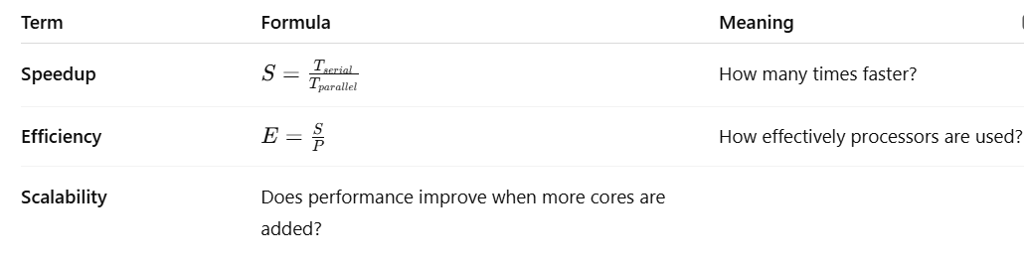
Foundation Metrics

Slide 19
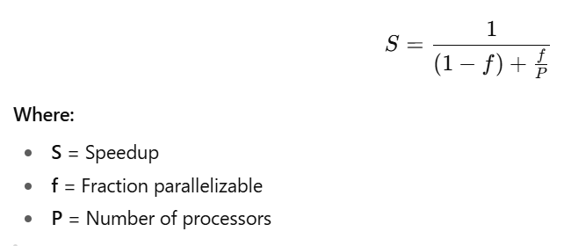
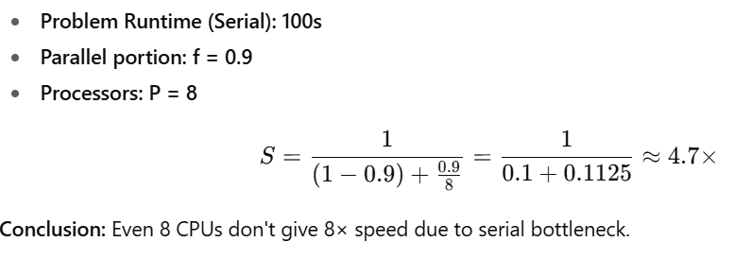
Amdahl’s Law Numerical Example

Slide 20
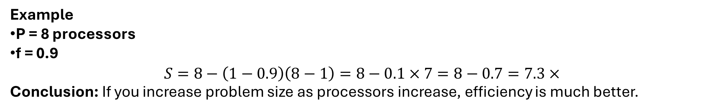
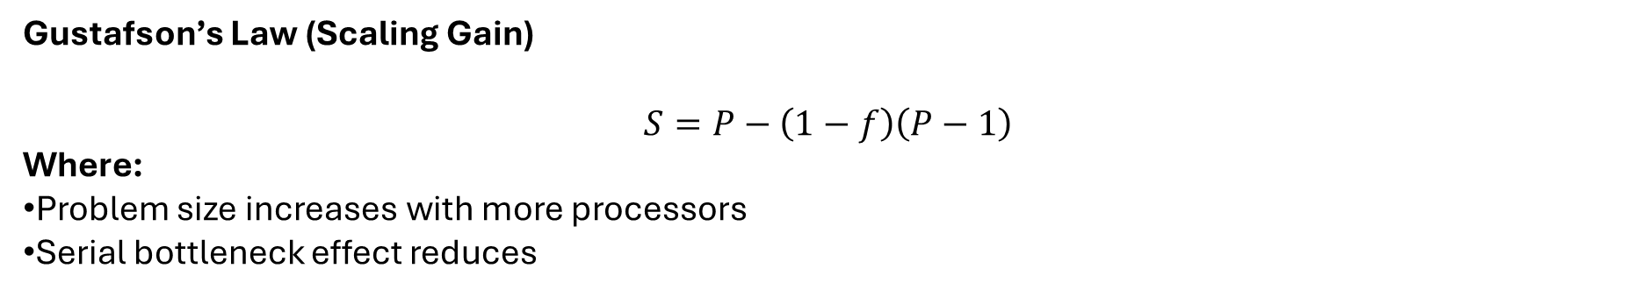
Gustafson’s Law (Scaling Gain)
$$S=P−\left(1−f\right)\left(P−1\right)$$
Where:
Problem size increases with more processors
Serial bottleneck effect reduces
Example
P = 8 processors
f = 0.9
$$S=8−\left(1−0.9\right)\left(8−1\right)=8−0.1×7=8−0.7=7.3×$$
Conclusion: If you increase problem size as processors increase, efficiency is much better.

